Slide 2

SolarDAO – The Digital Energy Cooperative
Current problems:
Many organization but lack of standardization across them
Difficult access to funding for projects with large investment
Lack of accessible funding (REScoop)
Relying of active participations of citizens and involvement of stakeholders
Problem with member organization and transparency
TODO= find data
Vasileios Panagiotidis Dipl. Ing.(FH), MBA – Founder of e-swissolar AG Co-Founder e-greeksolar Ltd, Poststrasse 9, 6300 Zug

Slide 3
SolarDAO – The Digital Energy Cooperative
Solution: Create tools for financing and governance
=> Give access to more fundings.
TODO: Show how the DAO works
Vasileios Panagiotidis Dipl. Ing.(FH), MBA – Founder of e-swissolar AG Co-Founder e-greeksolar Ltd, Poststrasse 9, 6300 Zug

Slide 4
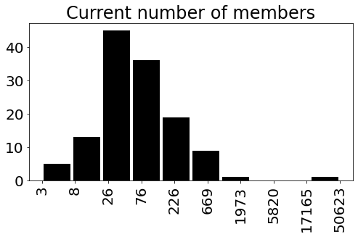
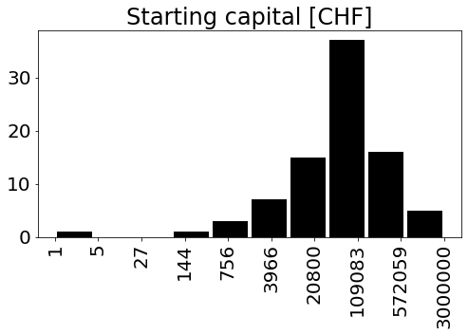
SolarDAO – The Digital Energy Cooperative
Different design for different participant:
Capital
Size
How to address the needs of everyone ?
Vasileios Panagiotidis Dipl. Ing.(FH), MBA – Founder of e-swissolar AG Co-Founder e-greeksolar Ltd, Poststrasse 9, 6300 Zug

Slide 5
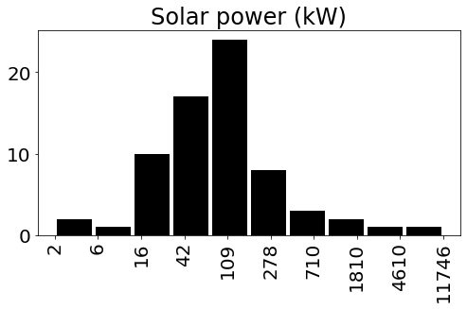
SolarDAO – The Digital Energy Cooperative
The DAO would help cooperative to become bigger, more powerful and more organize
So that they have more possibilities
70% below 100
Only 2 over 1000
Vasileios Panagiotidis Dipl. Ing.(FH), MBA – Founder of e-swissolar AG Co-Founder e-greeksolar Ltd, Poststrasse 9, 6300 Zug

